Slide 1

Project analysis slide 3
FAKE AD ALERT!!
IMPROVED CUSTOMER SATISFACTION
Bharath Janapareddi
Vidhi Shah
Kavya Nagaraju
Tejaswi Gundapaneni
Priyanka Patil

Slide 2





Project analysis slide 3
About the Dataset
DATA SOURCE
SCOPE OF DATA
RECORDED BY
DATA DIMENSIONS
SOFTWARE USED
The University of the Aegean
R Tableau Excel Data Studio
Kaggle.com
Data contains fake jobs posted on a Job listing website.
18 columns and 17,880 observations
Notes:
For the confidentiality purpose, company name is masked in the Dataset/ Data source.
We first identified the problem. Developed a plan of how will we analyze and derive conclusions.
Data cleaning was the first step – Softwares R, Tableau and Excel were used.
Care – Secondary reading was done on the loss incurred.
Do – Tableau and Data studio was used.
Impact – R was used, and a Logistic regression model was made to make predictions.

Slide 3






Data Cleansing
SALARY RANGE
MISSING VALUES
New column with Max value was created. Null values replaced with 0.
Replaced with “Not Mentioned”
17,880 rows 18 columns
JOB ID
FRAUDULENT VARIABLE
Variable removed
Calculated field was created in Tableau.
DESCRIPTION & BENEFITS
COUNTRY, STATE, CITY
Data mining – Text analytics.
Column was split for deep dive analysis.
Colors in this slide are for graphical purpose only.
Notes:
Data cleaning was performed on above variables.
New column was created to remove the effect of Salary range.
Missing values indicated no entry from the user posting the advertisement, hence they were replaced with “Not Mentioned”
Job ID was a numeric field which was not adding any value to our predictive model, hence it was removed.
Fraudulent had 0,1 values which were not working as Boolean values in Tableau, hence new field was created with TRUE/FALSE.
Description, Requirements, Benefits variables had unstructured blob data, hence text analytics and data mining techniques were performed.
To use the geo filter correctly in Tableau the variable Country, state and city was split into individual columns.

Slide 4
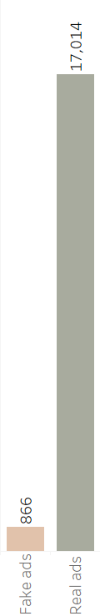


Care
“41% of viewership will be lost to 5% of fake ads accounting to an annual revenue loss of approximately $2.1M”
Reach of Negative review 1,732,000
Ratio of Negative to Positive review 41%
Average price of Ad listing $64.2
Average price of Ad listing per view $0.2568
Loss due to fall in Brand value $ 181,111 (Per month)
We see 4.84% of the job ads on the website are fake.
This impacts the reliability of the website.
Ultimately hampering the Brand equity and resulting to loss in revenue
Colors in this slide are for graphical purpose only. Calculation was made on 5% of fake ads identified from the data, for price and reach secondary source was referred.
Notes:
Our Audience is the Job listing website.
We first ran a quick EDA to check the number of Fake ads in the dataset. For better understanding we took a percentage.
Even though the 5% might look small, but if it interacts with lot of users it can damage a websites reputation and reviews.
Hence it is essential to do something.
A person spends 11 hours a week, spends 1 hour per job application approximately. Each corporate ad attracts 250 resumes.
Nearly two-thirds(65%) of the consumers would stop using the website, if they see false content which will result in severe.
Total ads - 17880 Average resume per ad 250 Total resume - 4,470,000 Fake ads - 866 resume sent to fake ads - 200 Total resume sent to fake ads – 173,200 WOM of negative review -10 Total reach of negative review - 1,732,000 Real ads - 17,014 Average resume per ad - 250 Total real ad resume - 4,253,500 only 1/10 of customer leave positive review - 425,350 Total reach of positive review - 4,253,500 Negative ratio 41% - 705,260 Average ad price - 64.2 Average ad price per viewer - 0.2568 Total revenue loss - 181,110.80
https://www.globenewswire.com/news-release/2019/06/17/1869379/0/en/Study-Consumers-Reject-Brands-That-Advertise-on-Fake-News-and-Objectionable-Content-Online.html
https://www.inc.com/andrew-thomas/the-hidden-ratio-that-could-make-or-break-your-company.html

Slide 5
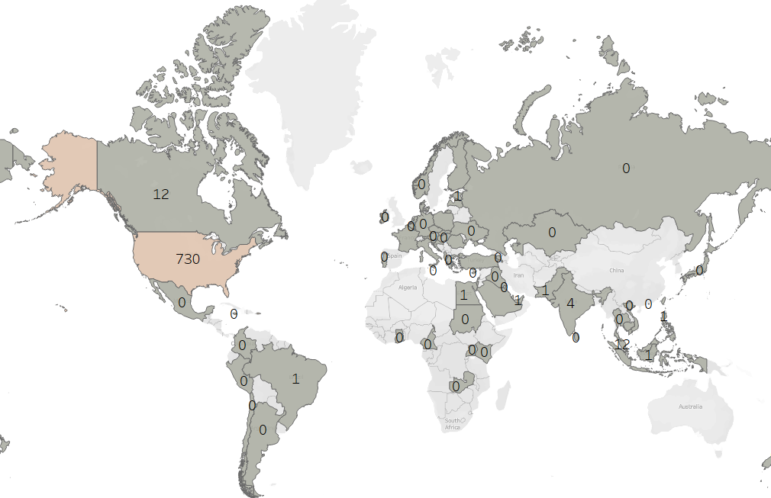
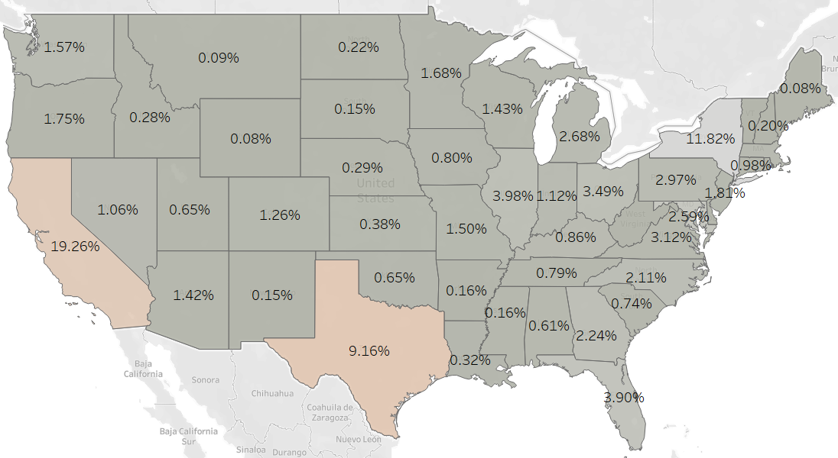
Project analysis slide 5
Which location has majority of fraud ads?
Initial findings
Average fake ads is
730
19.26%
Fake jobs out of 866 were listed from USA.
for California followed by NY at 11.82% and Texas at 9.16%
Beige shade indicates area to of further analysis.
Notes:
In the superficial EDA we saw majority of the fake job postings are from USA. Hence we decided to conduct in-depth analysis on USA. Since the company is masked, it is a possible that the Job listing website is having majority of the ad listed for USA only. We analyzed fake ads and found out that majority of them are posted from Texas -152 ads. (Texas was chosen over NY, because count of fakes ads was highest) But this could be because the total number of ads posted are more from Texas as compared to other states. Hence it was important to take a percentage of it to see which state is leading. And as we can see 20% of the ads posted for California(143) are fake.

Slide 6
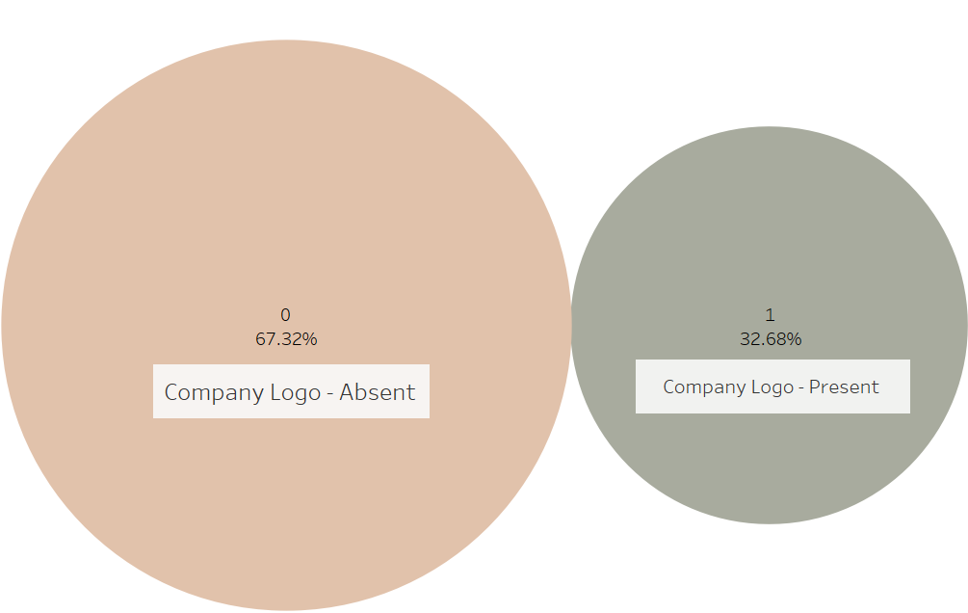
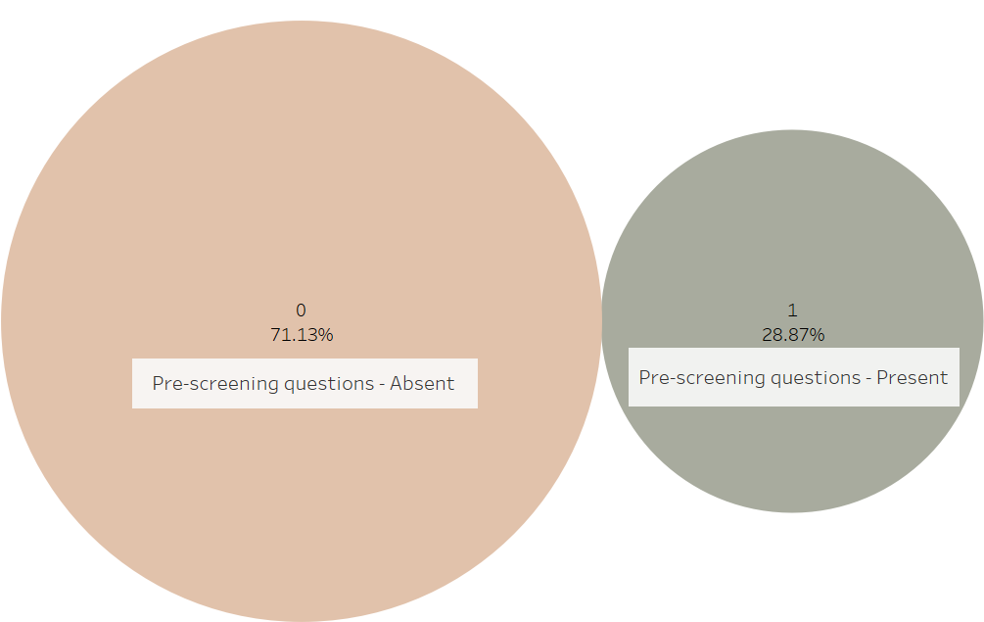

Project analysis slide 5
What is the effect of company logo and pre-screening questions on job ads?
Percentage of fake ad distribution based on company logo.
Percentage of fake ad distribution based on questions.
About 583 ads or
About 616 ads or
67.32%
71.13%
Of ads are fake, accounting for a total of 3.26% of ads.
Therefore, encourage companies to add logo and question, if an ad is posted without them an internal team should review it
of fake ads do not have pre-screening question, accounting for a total of 3.44% of total ads.
Notes:
It was observed out of 866 fake ads, we see that 583 ads of the total fake ads do not have a logo, which is equal to 67.32%. And it equals to 3.26% of the total ads posted. “If we recall total of 4.85% of the total ads are fake”. Thus having a logo in job ads would play a vital role for Job seekers as they will not be scammed and for job posters too, as rational candidates will not oust it out thinking it is a fake ad. Therefore company logo should be made mandatory.
It was also observed out of 866 fake ads, we see 616 ads of the total fake ads do not ask questions, which is equal to 71.13%. And it equals to 3.44% of the total ads posted. Thus we recommend our audience (job posting website) to encourage their clients to ask questions on their ads. They can say that an ad with questions attracts more viewership and eliminates incompetent applicants. However, if the ad is still posted without questions, an internal team should review the authenticity of the ad before publishing it.

Slide 7
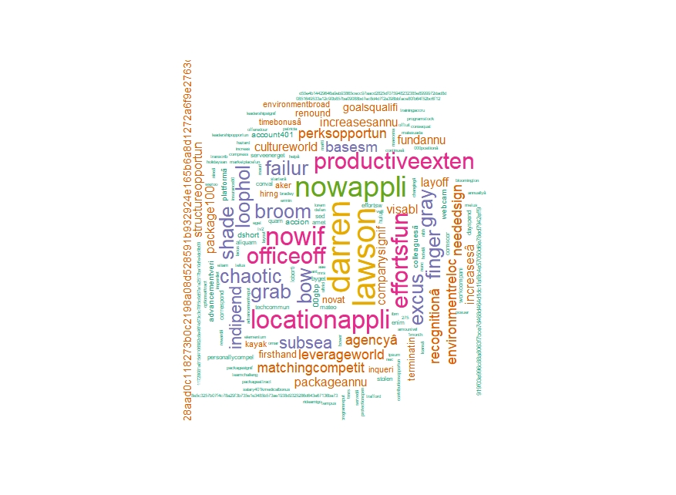
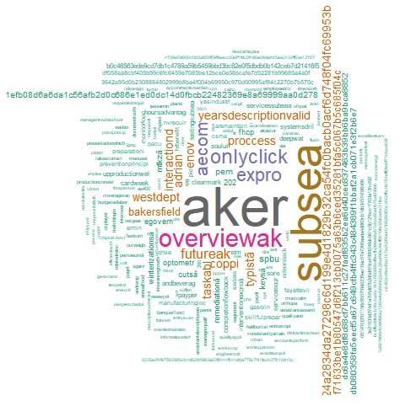
Project analysis slide 5
What is the effect of pre-screening questions on job ads?
Benefits
Description
Top words “Darren” “Lawson” are referred to individual person’s name from Aptitude staffing.
Top words “Aker” refers to a staffing company and “subsea” refers to Oil and Energy industry
Run text analytics to identify such fraudulent accounts and review them.
Notes:
Text analytics was performed on Description and Benefits fields in R studio. For Text mining we replaced alphanumeric chars with spaces and then deleted stop words from the field. Punctuation’s and the extra spaces were removed to account for the actual words that we might want to consider.
Word cloud was created for the words that appear only for the Fraud jobs in our dataset for these unstructured variables.
There were many repeated words observed in the different fields. Therefore we made sure to pick distinct words relative to the respective fields. Example Darren Lawson is a person from Aptitude staffing, which is a company based in California. This connects to all our findings so far which can be used on monthly basis to identify such fraudulent advertise.

Slide 8
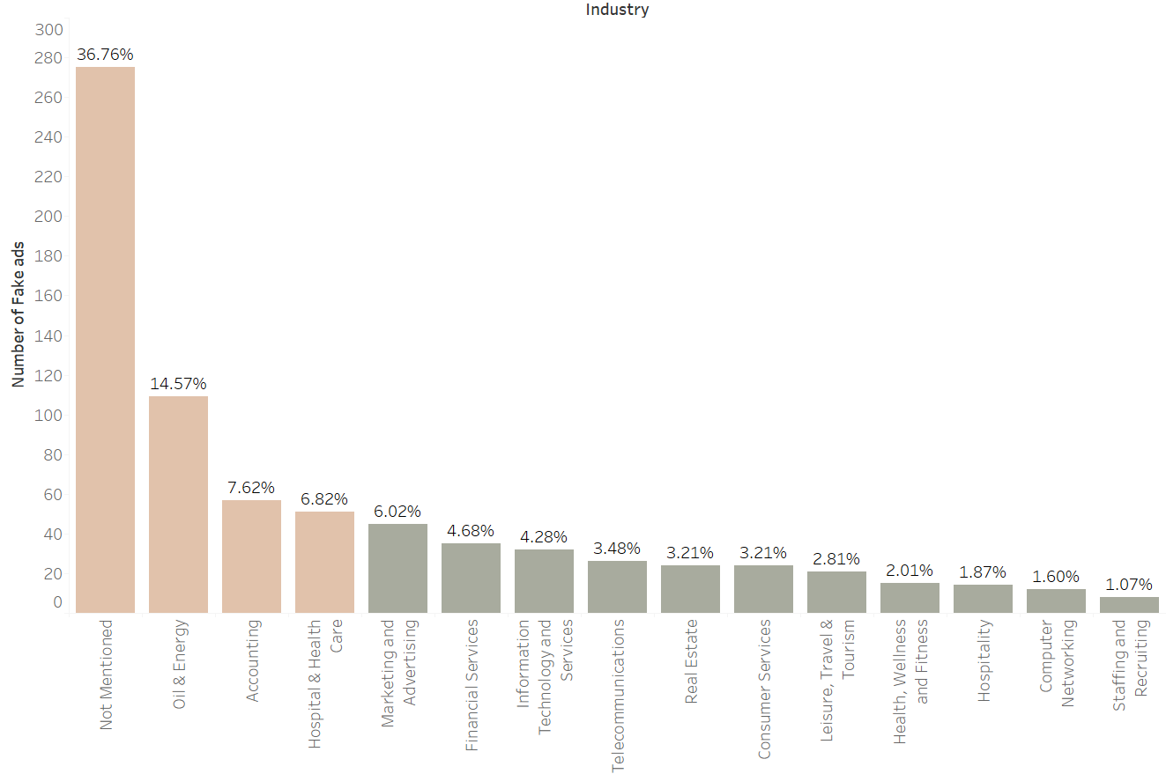
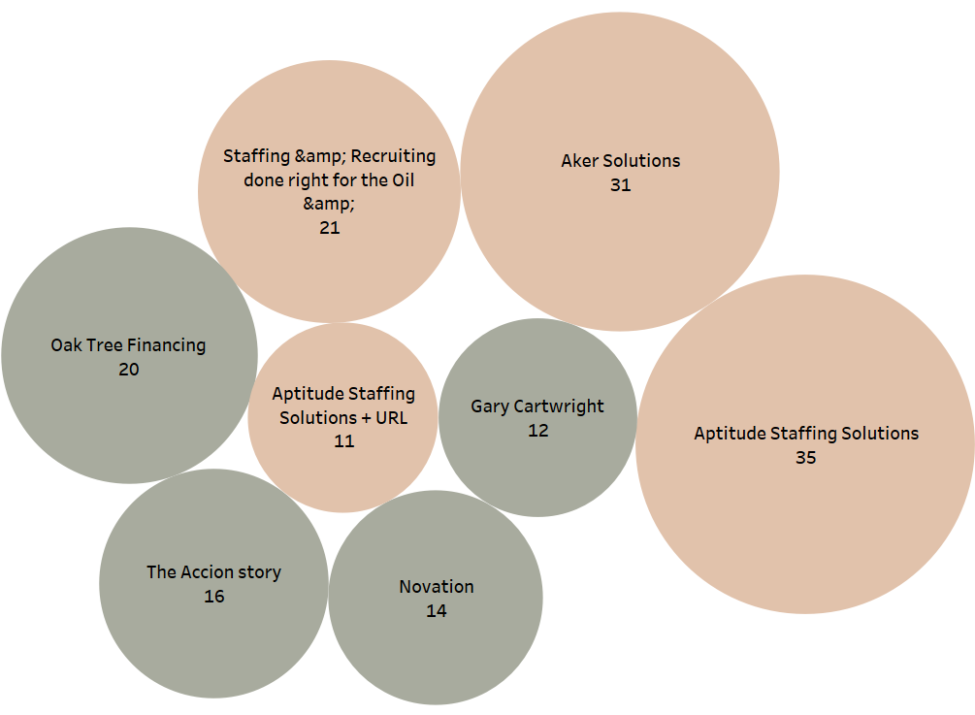

Project analysis slide 5
What is the industry wise classification of fake ads posted?
Therefore, make industry type a mandatory field and use text analytics model to generate high frequency words in this ad and compare it with the fraud ads result.
Further analyzing the top 3 industries from he figure on left we were able to pin-point companies with maximum fraudulent ads.
Therefore, make company name a mandatory field and create a vector of identified fake ads, which will put the new ads directly for review.
36.76% of the Fake ads do not have anything listed under the industry type.

Slide 9
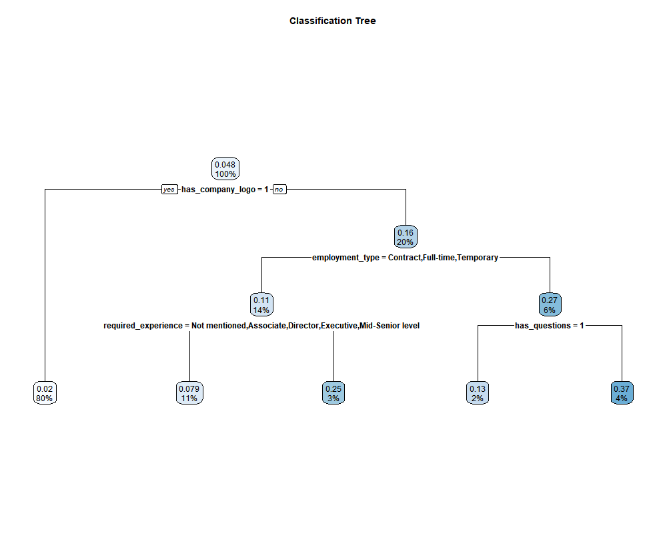
Project analysis slide 5
Model
Decision Tree
We see 80% of the training data having a company logo have 2% probability of being a Fake ads.
We see 6% of the training data do not have company logo and employment type is not mentioned. And have 27% probability of being fraudulent.
We see 4% of the training data do not have company logo, employment type is not mentioned and has no questions asked. Then there is 37% probability of an ad being fraudulent
Therefore, we back our recommendations of making these fields mandatory.
Notes:
Rstudio was used to run a classification model for cross validating our EDA results.
Training data did not have descriptive variables, and only variables with low VIF values were used. Text analytics was performed on descriptive string variables.
We would recommend the company to make the highlighted fields mandatory as this would possibly oust out the fake/scam ads posted by bots and scamsters. R code is attached for reference.

Slide 10






Project analysis slide 5
Impact
Improve viewership and attract more resumes as on an average a job seeker spends only 72 seconds on an ad.
As reliability increases website can help the company to attract more than the average 250 resumes per ad.
More viewership will ultimately result to an increase in popularity, leading to command a price premium.
Improved Customer Satisfaction Index by reducing 1 hour/week spent on fake ads.
Prevent customers from exposing PII (Personally Identifiable Information) to scammers.
Maintain and Improve brand value by filtering fake ads and save $2.1M of revenue.
Notes:
An average person applies to 10 jobs per week and spends 11 hrs in total per week.
average a person spends 1.1hrs behind each add this person is losing 1hr in a week on fake/scam ads
source - https://zety.com/blog/hr-statistics
https://www.zipjob.com/blog/how-many-jobs-applications-should-you-be-sending-out/

